Slide 1


Capstone Project Phase B - 24-1-D16
David Asulin
Gal Danenberg
Supervisor: Alex Keselman

Slide 2
Table Of Content
Introduction and Project review
3
The Problem
4-7
The Solution
8
Advantages
9
Development Procedure
10
Research
11
Technologies
12-16
UML Diagrams
17-21
UI/UX Demo
22-25
Verification and Testing
26-28
Expected Challenges
29

Slide 3

Introduction
In today's world, getting healthcare guidance often feels like a time-burden. Waiting on hold for ages or spending hours at a clinic just to ask a quick question can be frustrating.

Slide 4
Project Goals
Provide an accessible and affordable healthcare solution.
Help users with their health information.
Encourage people to take care of their health.

Slide 5




The Problem
There are many challenges today within the healthcare department, whether its through traditional face-to-face appointments or online platforms such as messaging or using phone services for consultation, today we will explore some of those obstacles and show our solution.
Long Wait Times
Patients often face long wait times for appointments and consultations.
Limited Access
Physical presence required for many healthcare services.
Phone Consultations
Long wait times for phone services and health advice.

Slide 6
Limited Access and Complexity
1
Physical Presence Required
2
Complex Scheduling
3
Phone Service
Complex appointment scheduling and long wait times exacerbate access issues.
Phone services such as consultant or health advices are given by a nurse and not a doctor.
Traditional healthcare consultations require physical presence, which can be challenging for those with mobility issues or in remote locations.

Slide 7
Cost Barriers
Subscription Models
User Interface Challenges
Many existing online consultation platforms require subscriptions or payment per consultation, which can be prohibitive for individuals needing only occasional advice.
User interfaces are often not intuitive, reducing accessibility for those with limited technical skills or disabilities.

Slide 8

Unequal Access to Healthcare
There are big differences in how easily people can get medical advice, depending on where they live and their financial situation.
For example :
1
United States Healthcare
2
Rural Healthcare Access
In the United States, healthcare is often not free, and individuals may need insurance coverage or significant financial resources to access medical advice.
Village areas may have limited access to healthcare facilities and specialists, making it harder for residents to receive timely medical advice

Slide 9




The Solution - MediChat
A free AI health consultant chatting platform with multiple language options, This platform will make seeking medical advice and diagnoses easier, helping to lighten the load on healthcare providers and reduce unnecessary visits to medical facilities, and make the process less of a burden.
AI Chatbot
Medical Advice
Free of charge
Intelligent health consultation
Easy access to health information
A free platform that everyone can use

Slide 10
Advantages of MediChat
1
No Wait Time
2
Cost-Free
No need to wait for an appointment
Free of charge
3
User-Friendly
4
Universal Access
Simple and easy to use
Can be used on every device that has access to the internet

Slide 11
Development procedure
1
Planning
Define project scope and requirements
2
Design
Create system architecture and user interface
3
Implementation
Develop the AI chatbot and integrate with healthcare databases
4
Testing
Conduct thorough testing and quality assurance
5
Deployment
Launch MediChat and monitor performance
6
Maintenance
Regular updates and improvements

Slide 12
Technologies

Slide 13

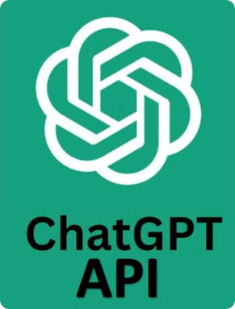
ChatGPT API
The ChatGPT API is a tool that developers can use to add conversation abilities to apps and services. It's powered by advanced artificial intelligence, allowing it to understand and respond to text inputs in a way that feels natural and human-like.

Slide 14
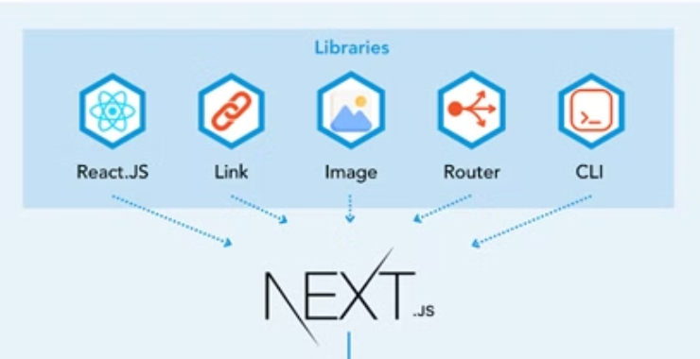
Next.js - MongoDB Architecture
MongoDB
Next.js
React
Node.js
A NoSQL database used for storing and managing data.
A React framework for building server-side rendered applications.
A JavaScript library for building user interfaces.
A JavaScript runtime environment for building server-side applications.

Slide 15

Vercel
Vercel deployment provides an easy way to host web applications, giving developers a seamless experience from code to production. This cloud platform uses its global edge network to ensure static content delivery and optimal performance.

Slide 16
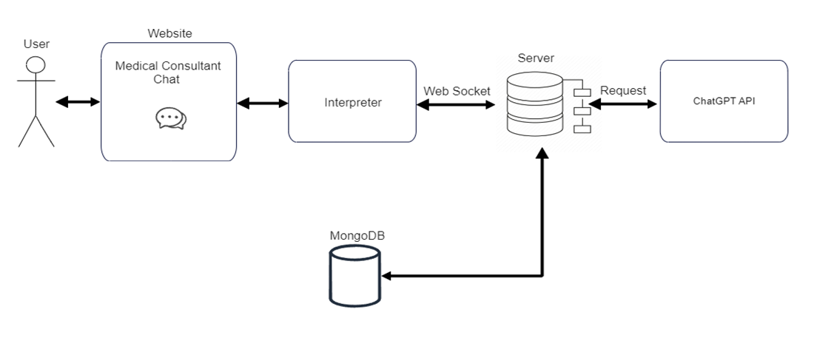
Architecture

Slide 17
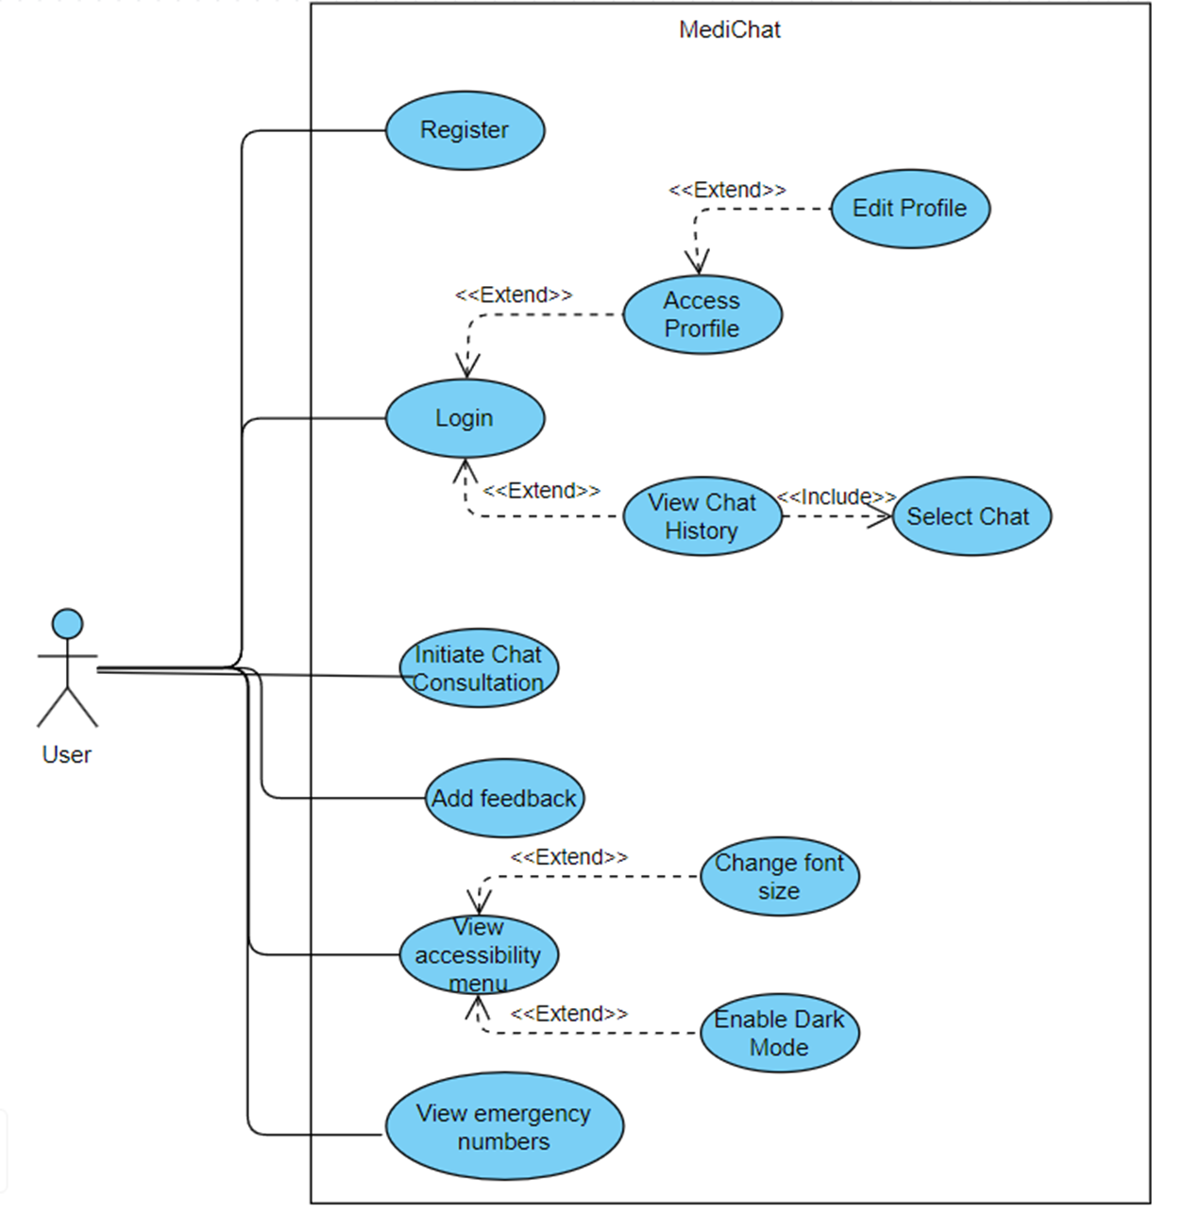
Class Diagram

Slide 18
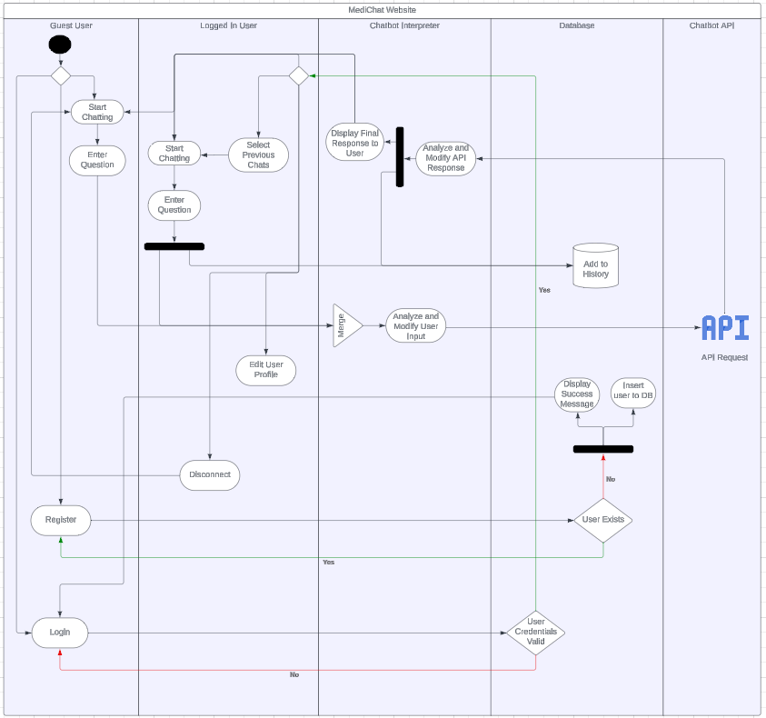
Activity Diagram

Slide 19
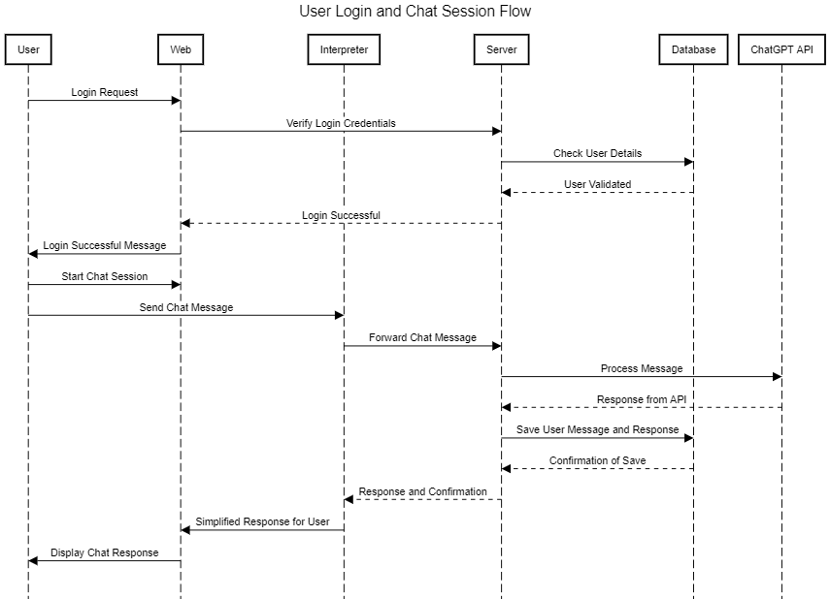
Package Diagram

Slide 20
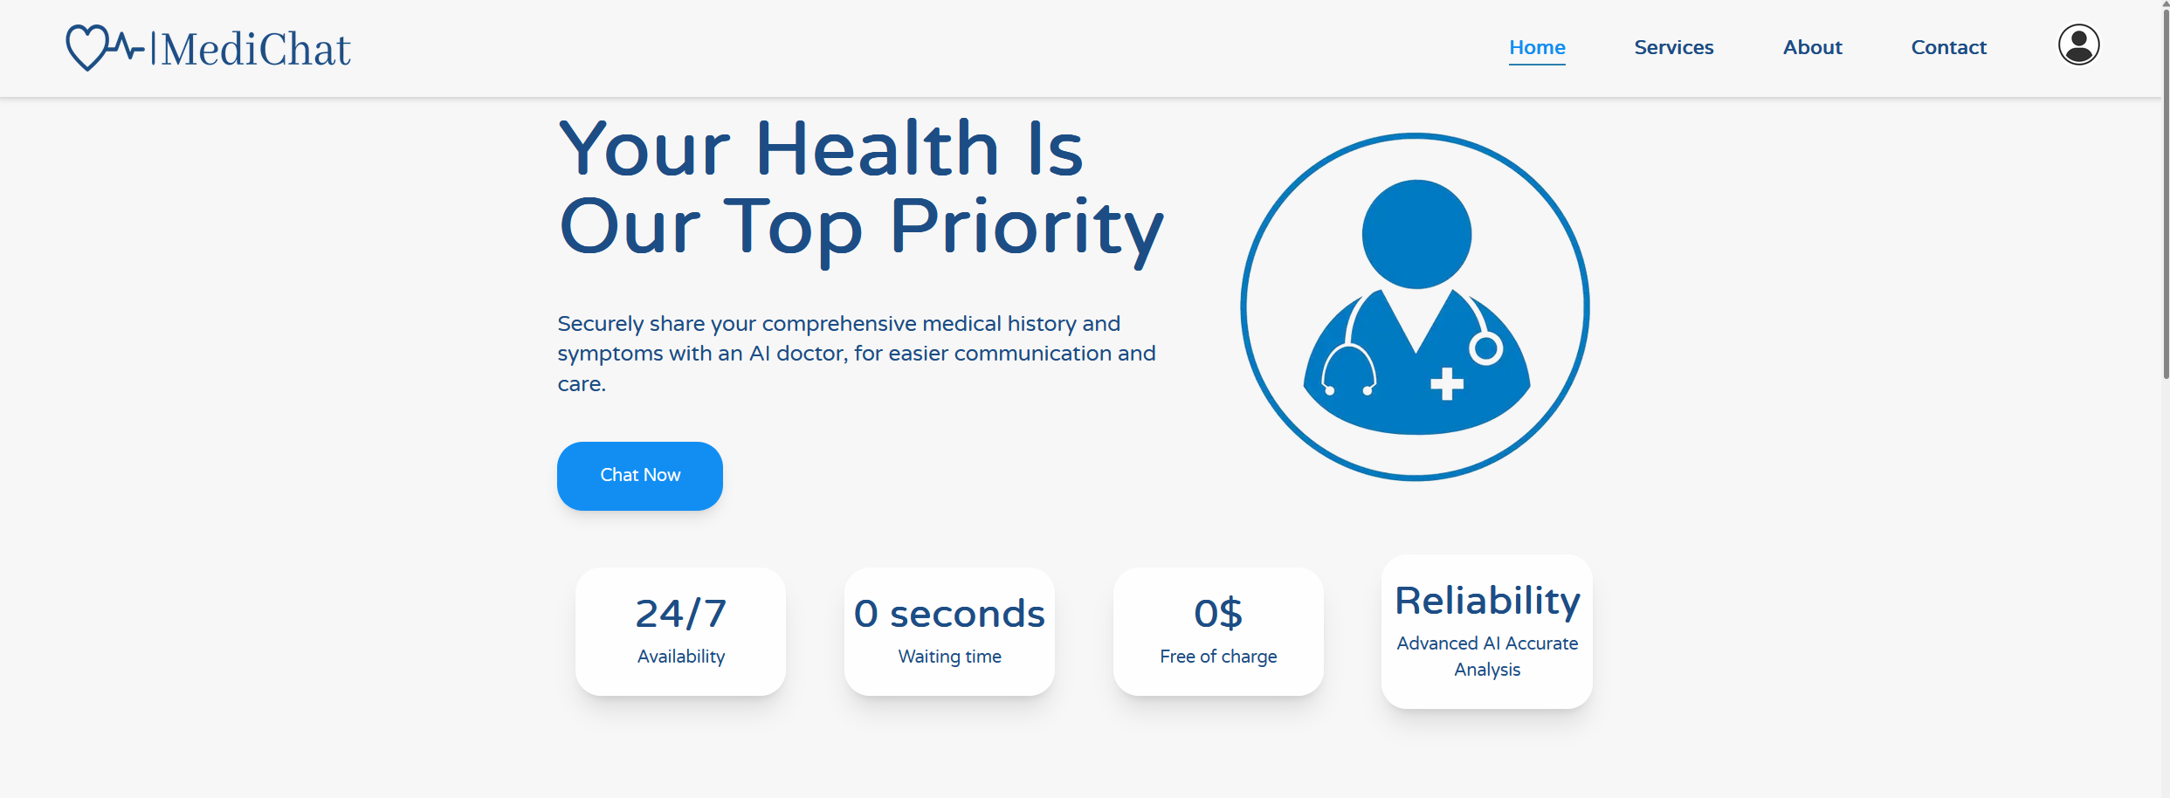
Main Screen

Slide 21
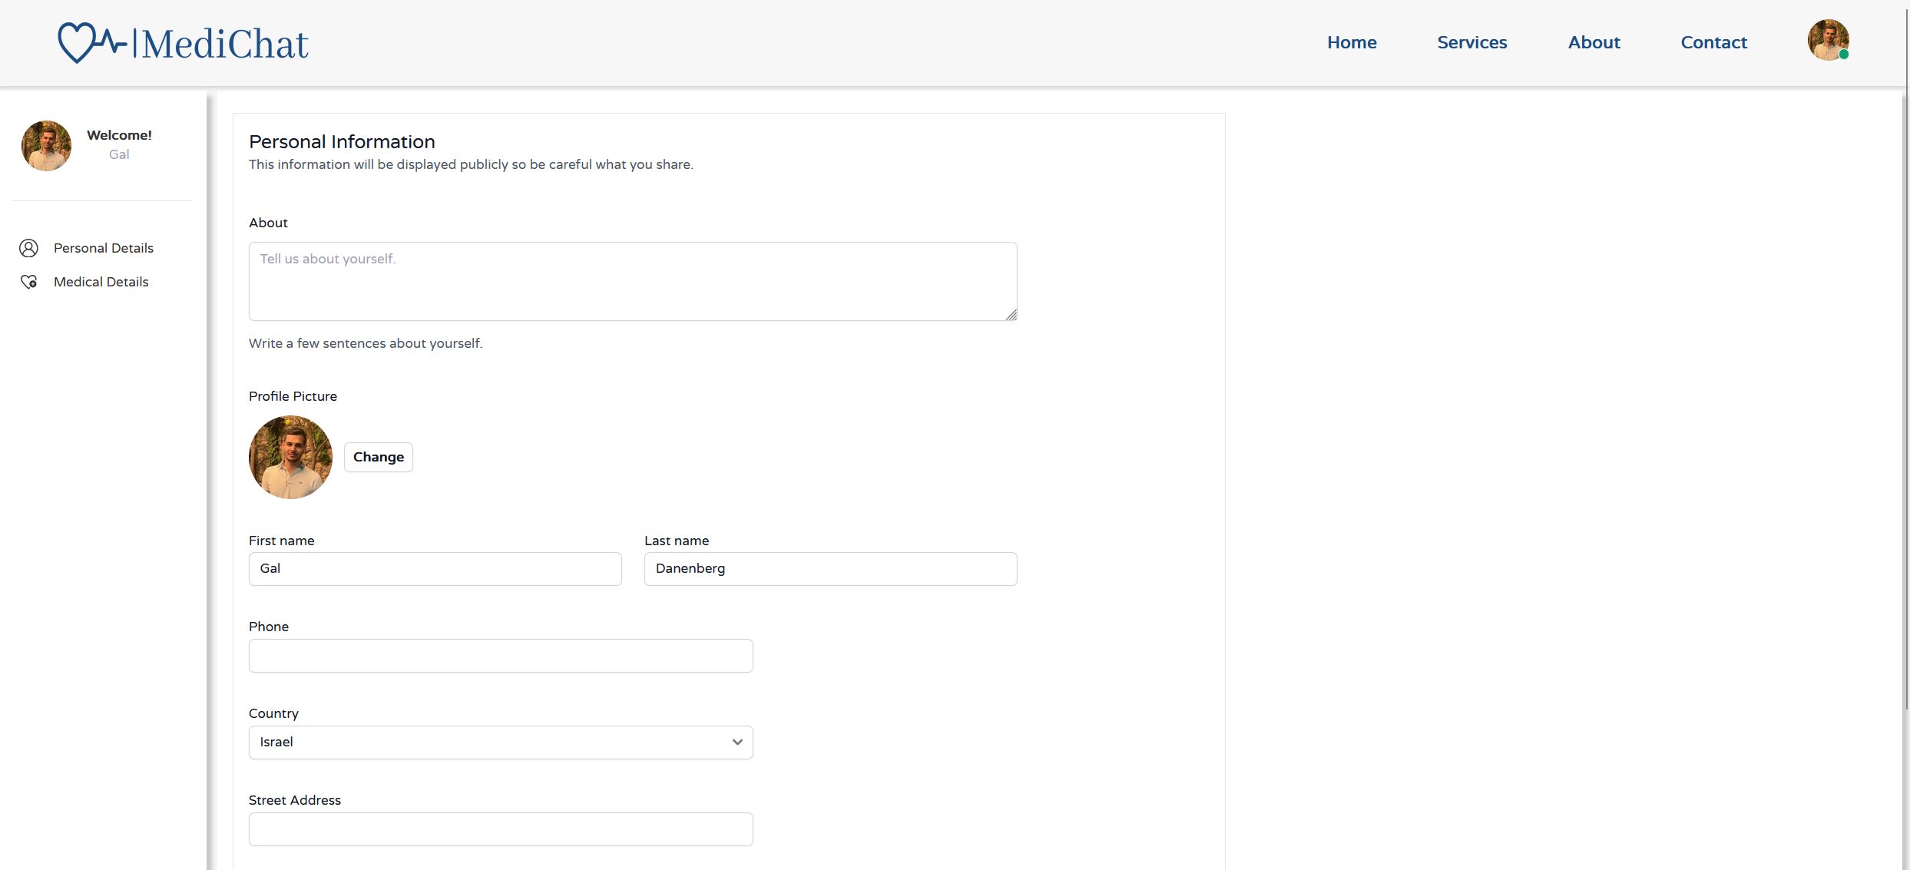
Profile Page - Personal

Slide 22
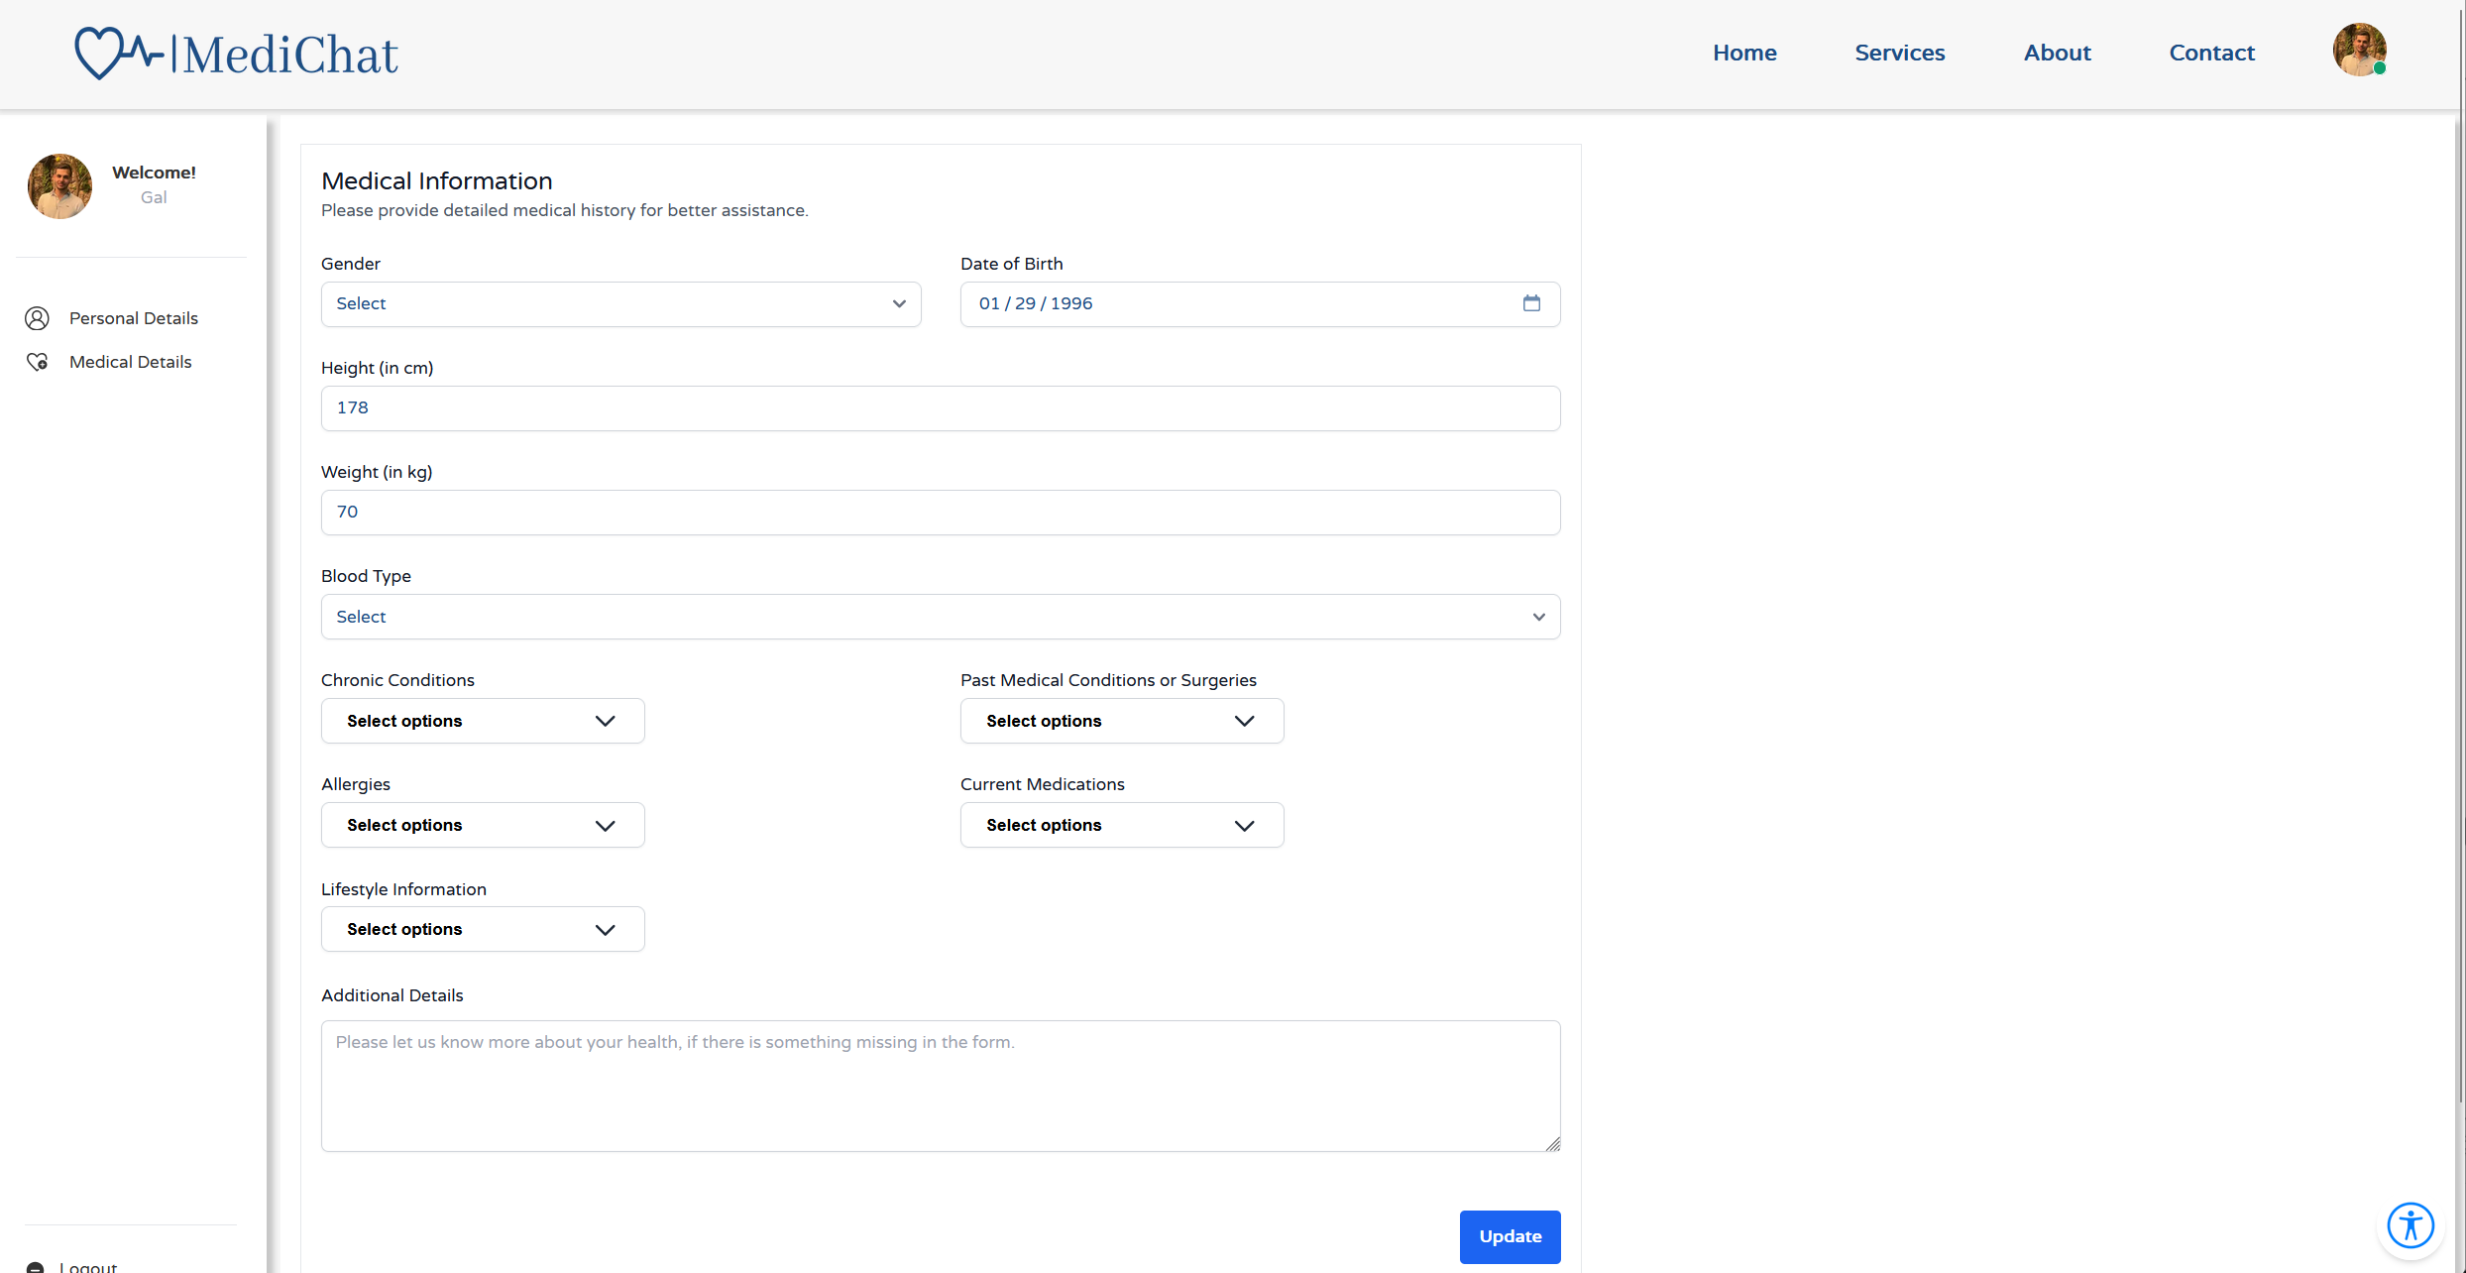
Profile Page - Medical

Slide 23
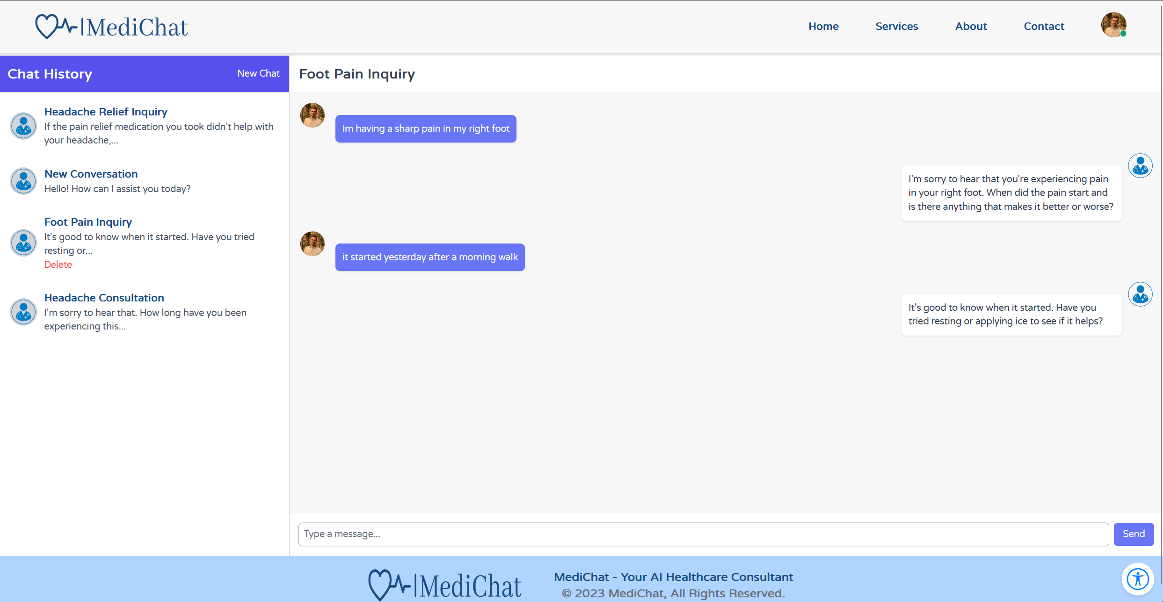
Chat window

Slide 24
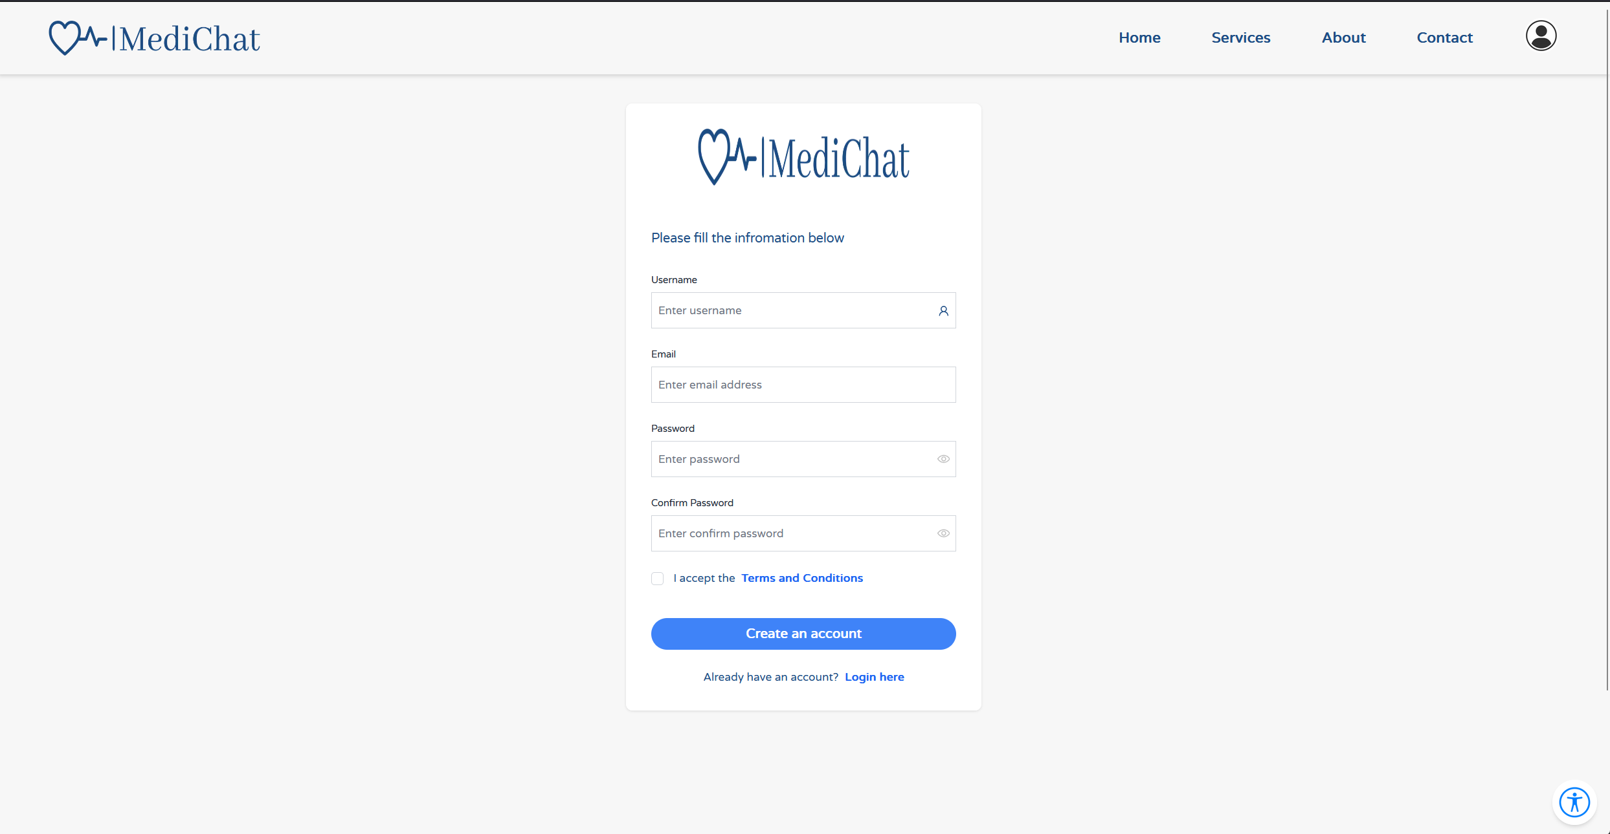
Registration

Slide 25
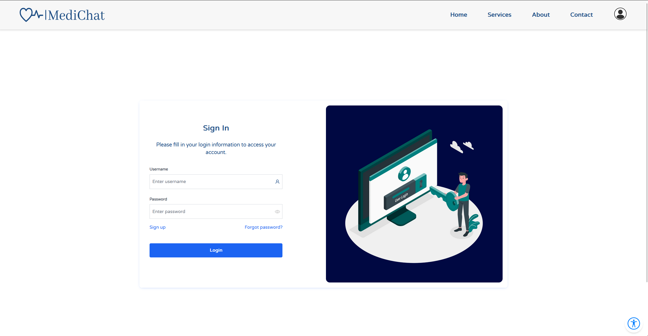
Login window

Slide 26


Verification And Testing
Our testing strategy will be divided into two distinct components:
- Frontend Testing
- Backend\API Testing

Slide 27


Git branching
Staging branch
Production branch
This branch is used to develop new features and bug fixes.
This branch contains the live code that is deployed to users.

Slide 28

FrontEnd Testing
For the frontend testing of our application, we have chosen Playwright, a testing tool known for its ease of use and robust testing capabilities. Playwright excels in running automated tests written in JavaScript, allowing us to simulate real user interactions on web pages.

Slide 29

BackEnd Testing
On the backend, we will also use Playwright’s framework to ensure the reliability and functionality of our APIs. Playwright is favored for its versatile and straightforward approach to both simple and complex test cases.

Slide 30
Thank You!

